Slide 1
Hurricane Michael 2018 case:
Validation Progress and Challenges
Anil Kumar & Andre
and EMC team

Slide 2
HWRF, HRRR & LES Hurricane Michael 2018

Slide 3
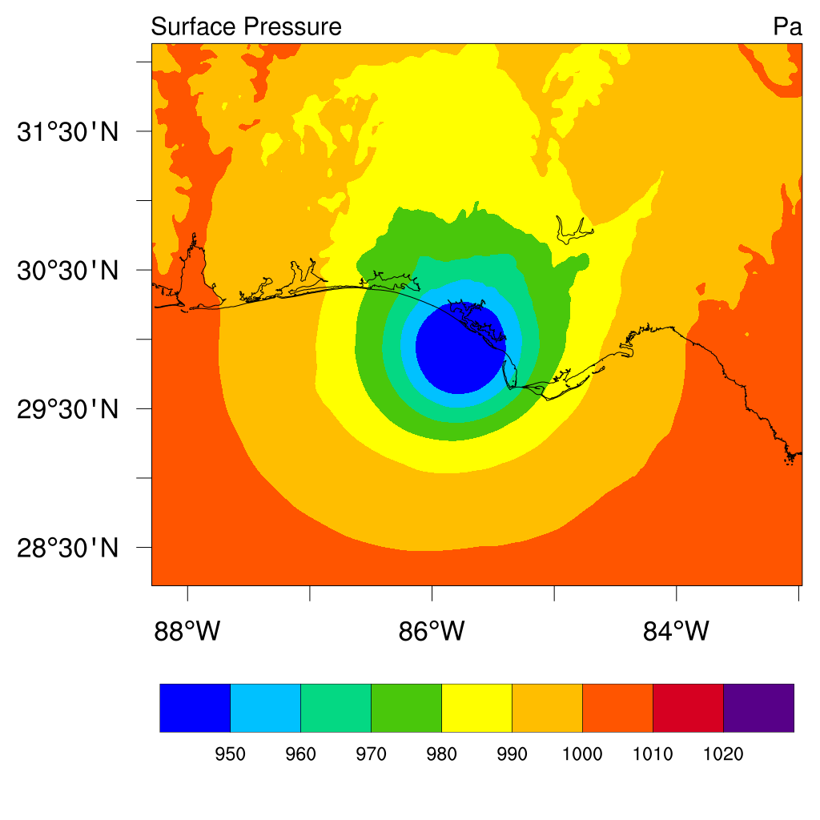
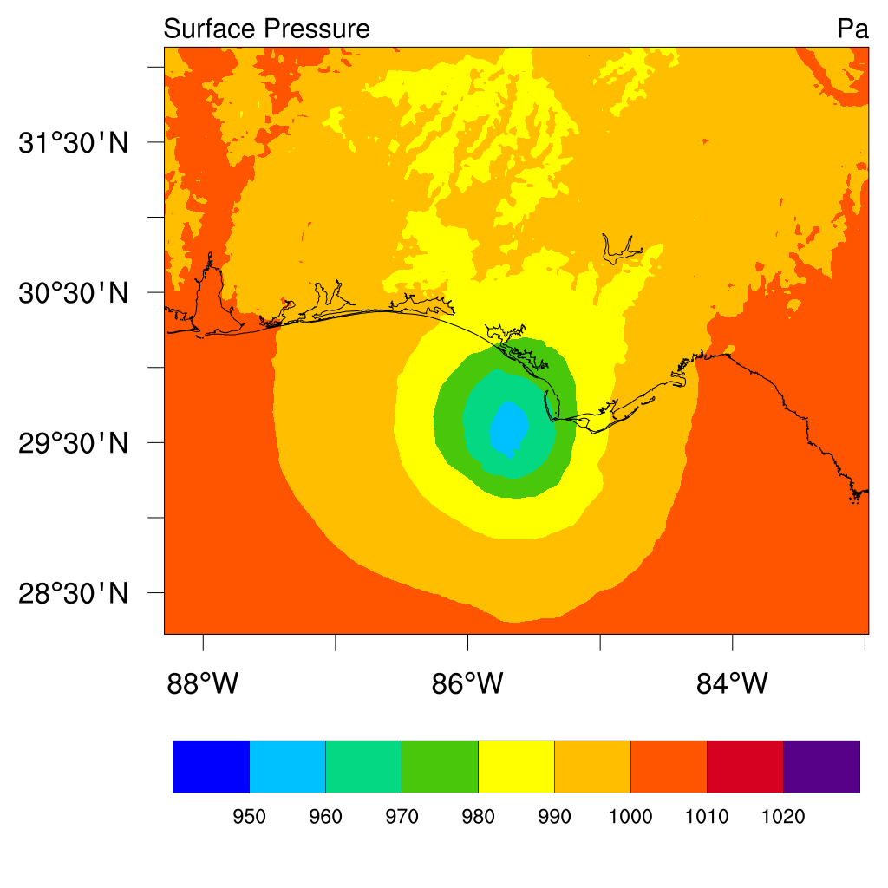
1700 UTC 10 Oct 2018
HWRF
HRRR

Slide 4
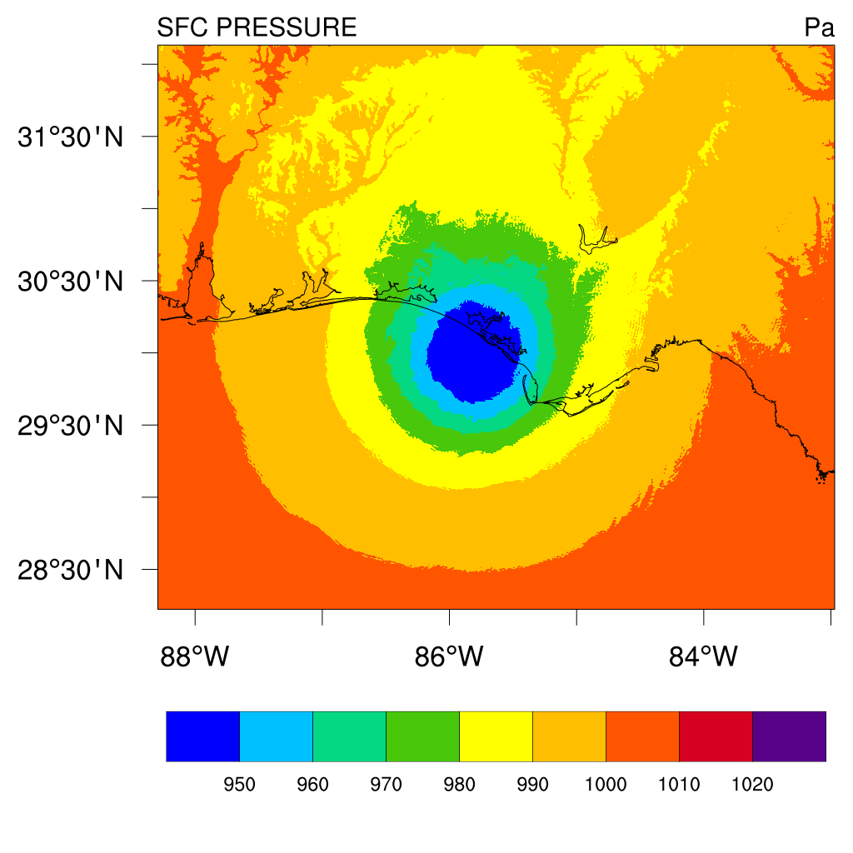
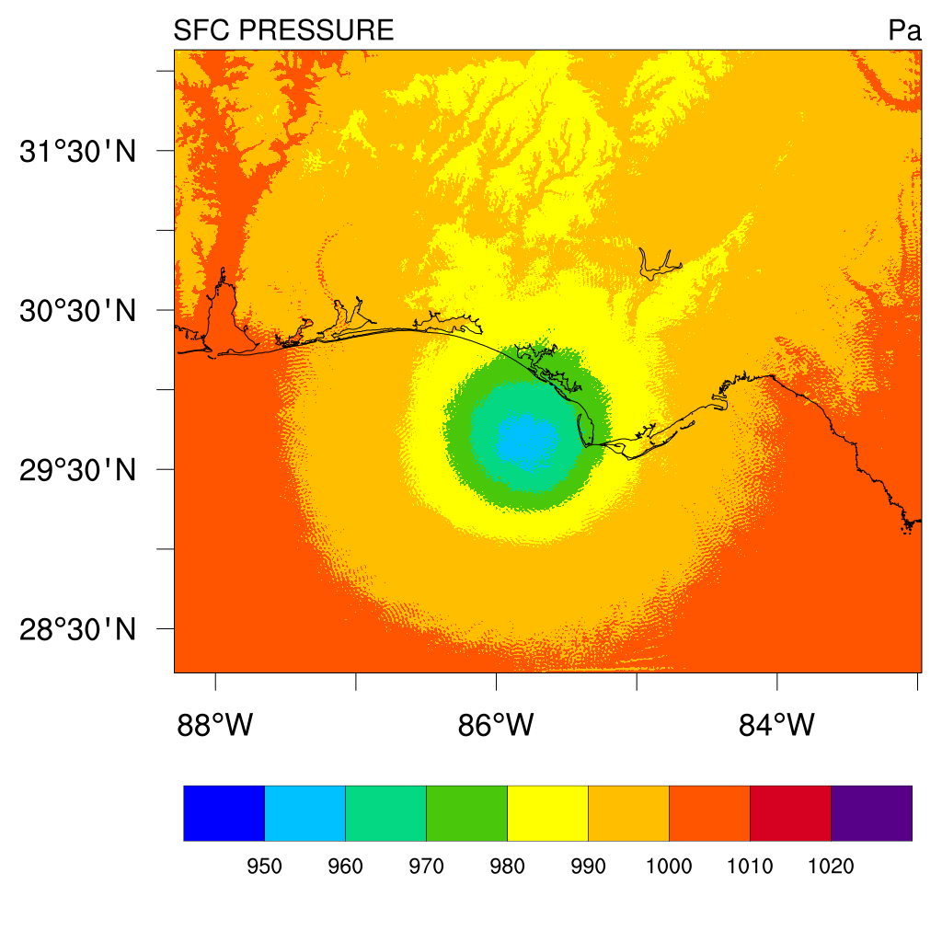
1700 UTC 10 Oct 2018
LES-HWRF (DOMAIN1 - 300 m)
LES-HRRR (DOMAIN1 - 300m)

Slide 5
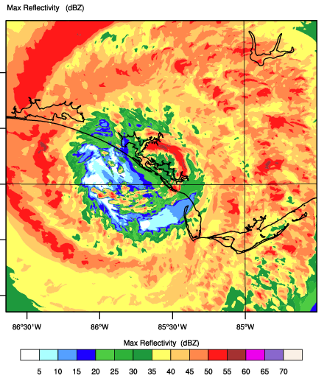
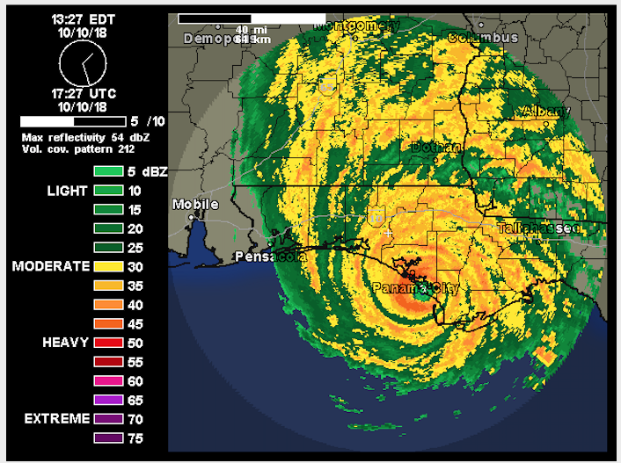
HWRF/LES Eye
Observed Eye
Model Reflectivity dBZ Domain 2 (90 meter)

Slide 6
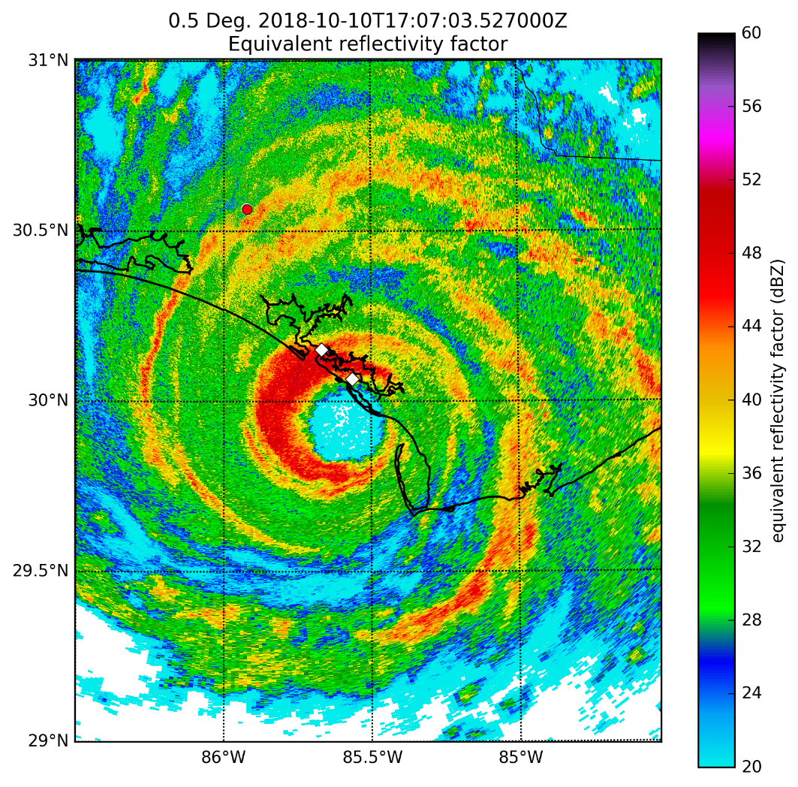
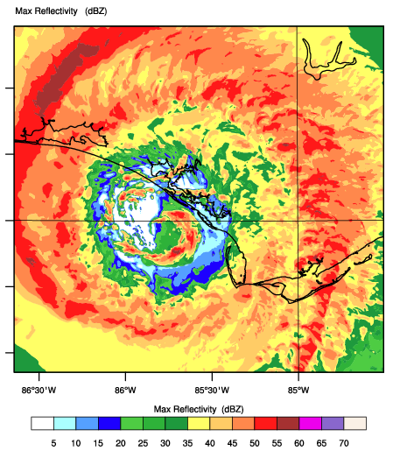
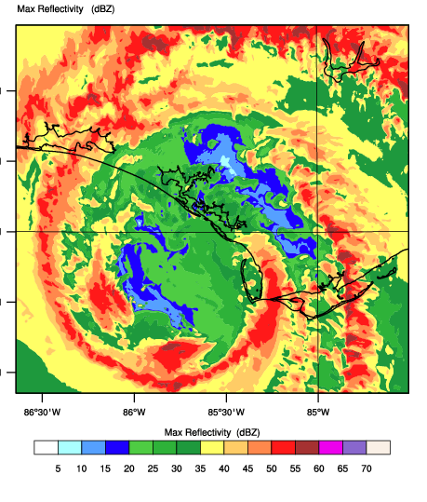
0600 UTC 17 OCT 2021
NEXRAD
LES_HWRF FROM DOM2 - 90m)
LES_HRRR FROM DOM2 - 90m)
MODEL REFLECTIVITY COMPARED WITH NEXRAD REFLECTIVITY

Slide 7
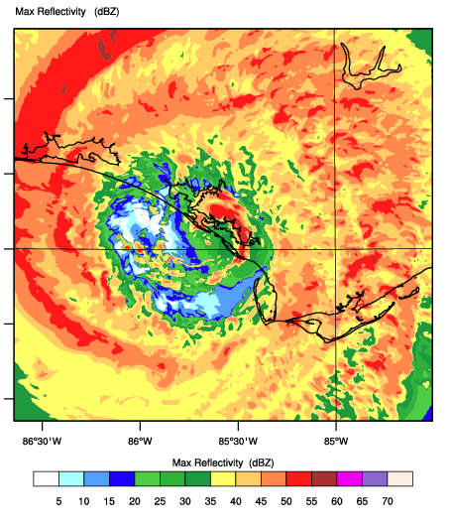
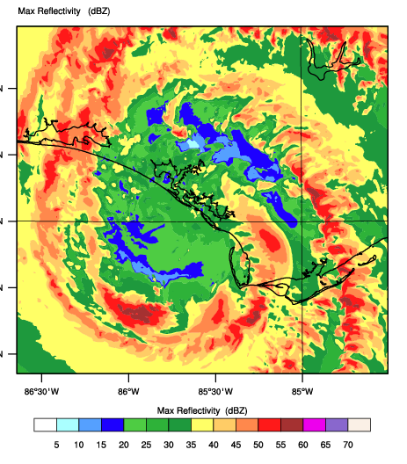
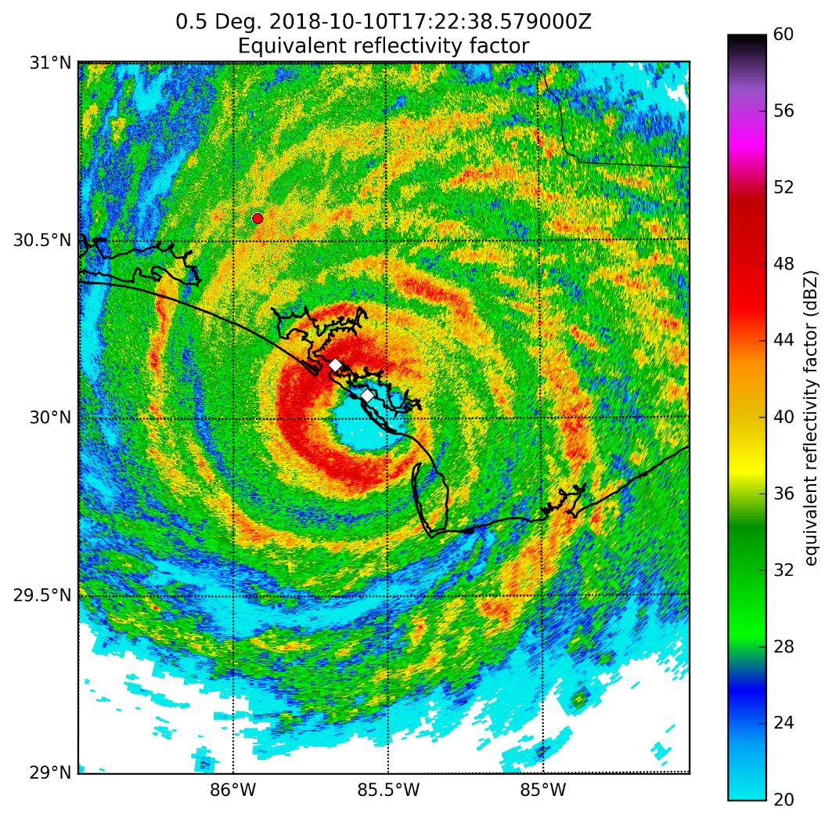
2400 UTC 17 OCT 2021
NEXRAD
LES_HWRF
LES_HRRR
MODEL REFLECTIVITY COMPARED WITH NEXRAD REFLECTIVITY

Slide 8
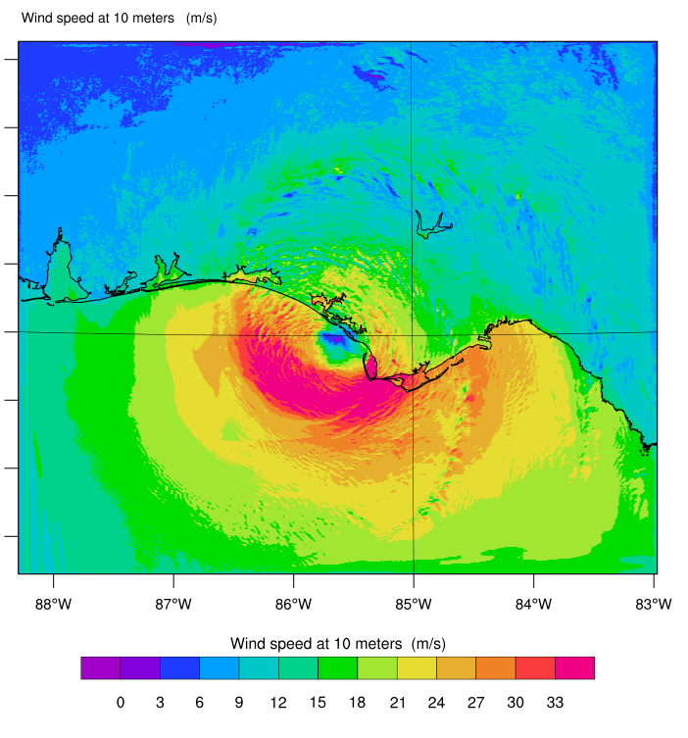
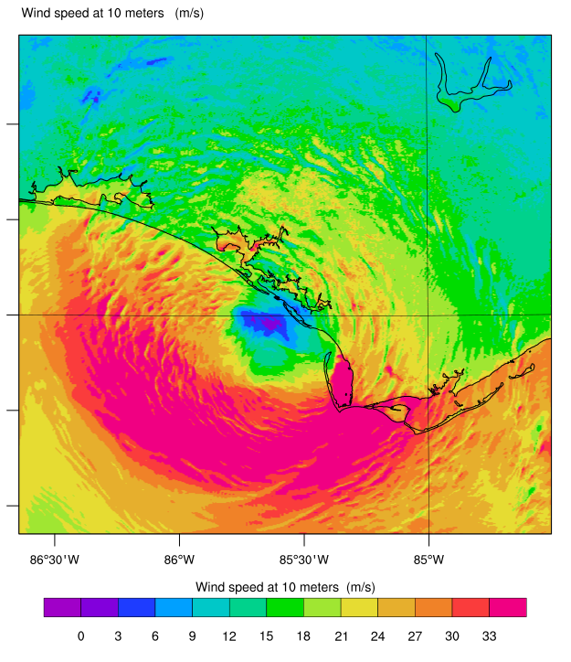
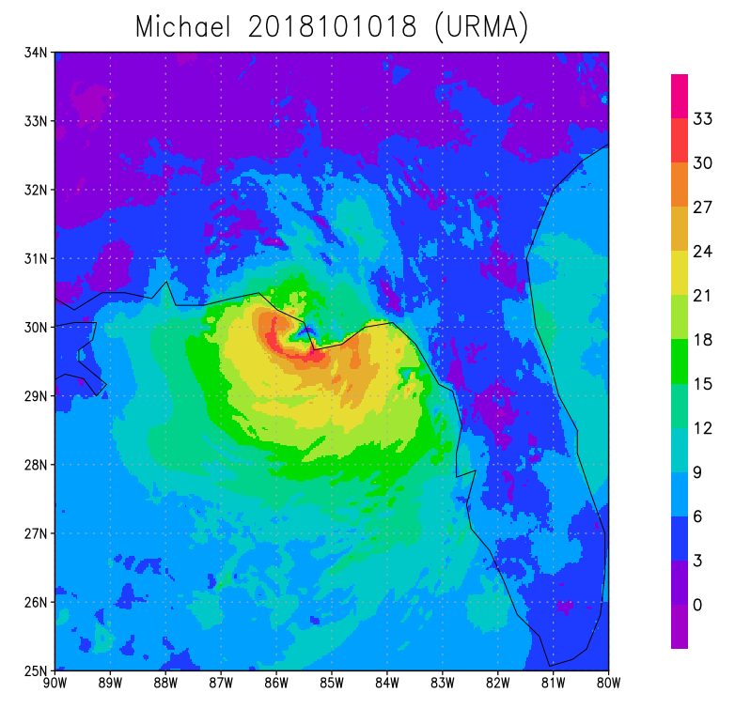
DOMAIN1
LES USING HRRR
WIND SPEED at 10-m
18 UTC 10 OCT 2018
DOMAIN2
URMA/HRRR
NEXRAD

Slide 9
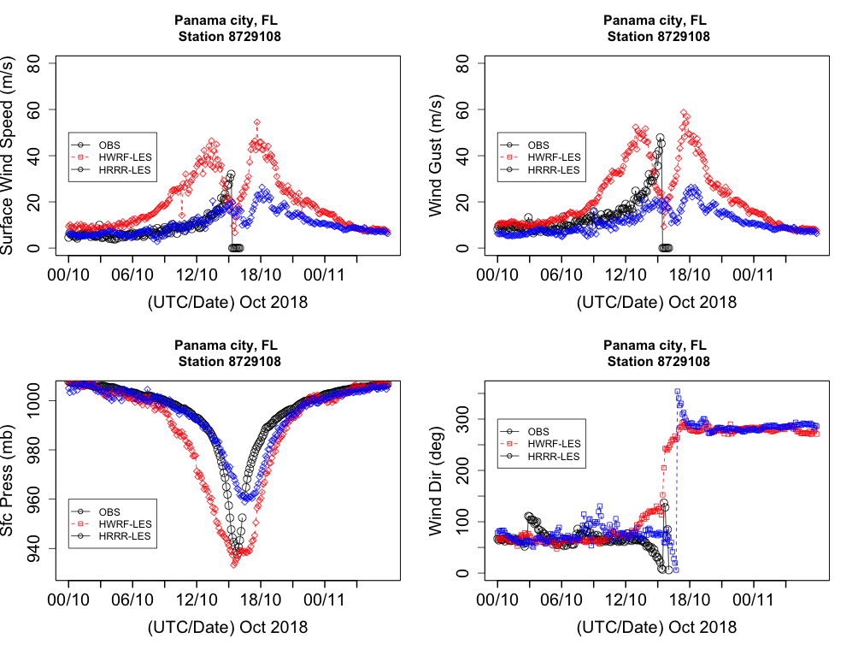
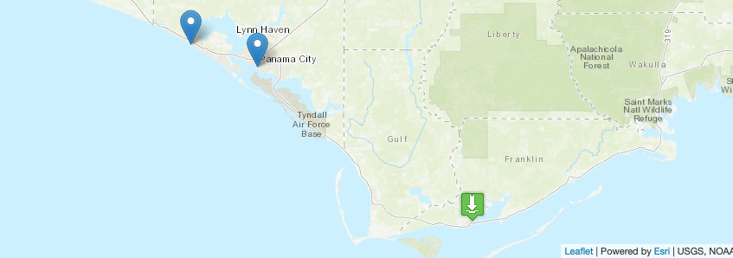
RED – LES USING HWRF FORCING
BLUE – LES USING HRRR FORCING
BLACK – OBSERVATIONS
6-MINS INTERVAL DATA & MODEL VALIDATIONS

Slide 10
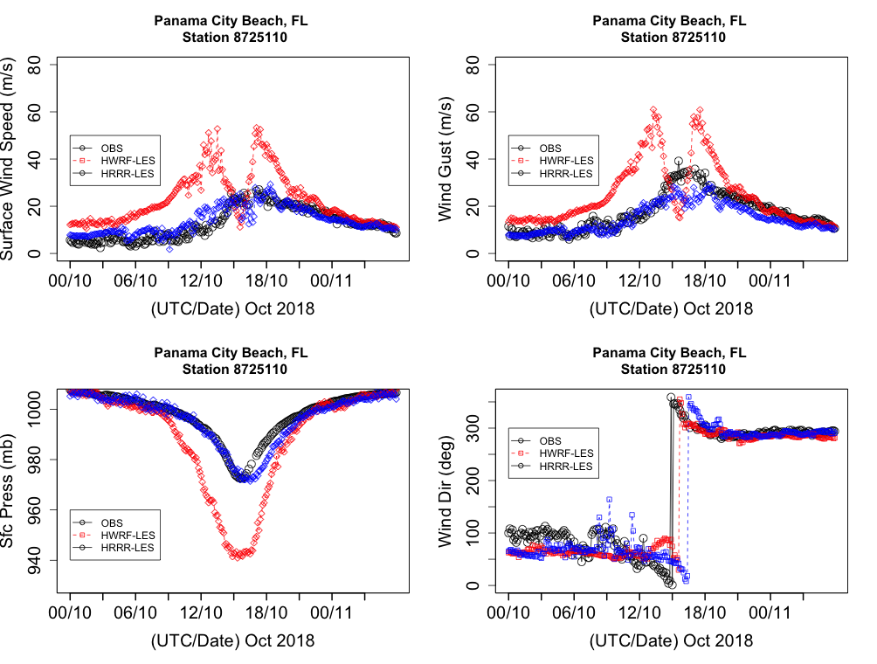
RED – LES USING HWRF FORCING
BLUE – LES USING HRRR FORCING
BLACK – OBSERVATIONS
6-MINS INTERVAL DATA & MODEL VALIDATIONS

Slide 11
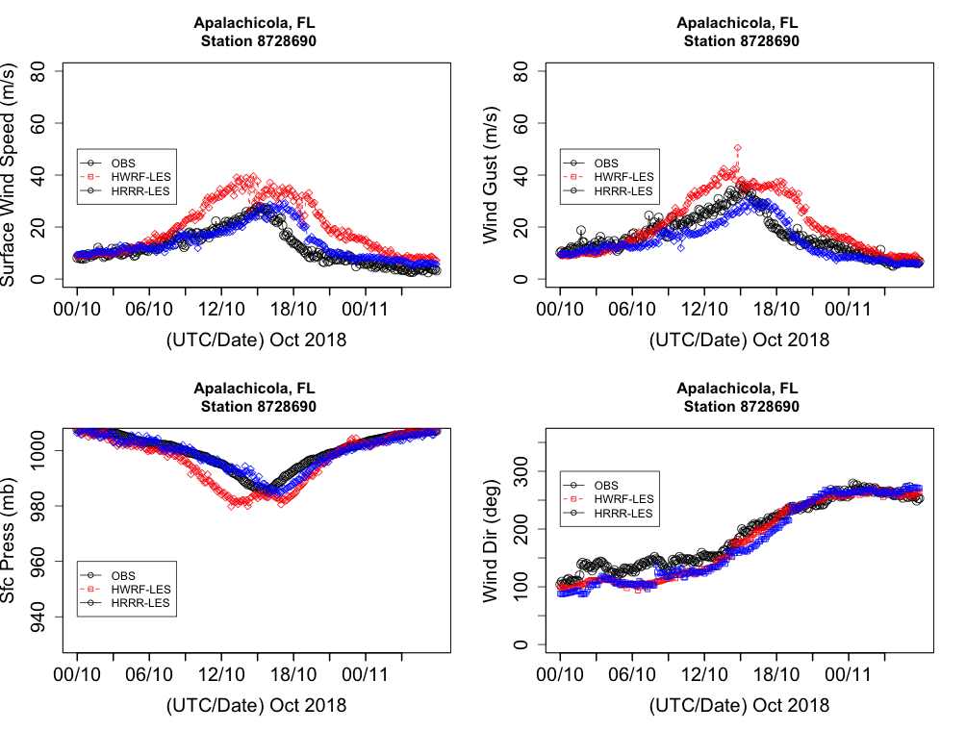
RED – LES USING HWRF FORCING
BLUE – LES USING HRRR FORCING
BLACK – OBSERVATIONS
6-MINS INTERVAL DATA & MODEL VALIDATIONS

Slide 12
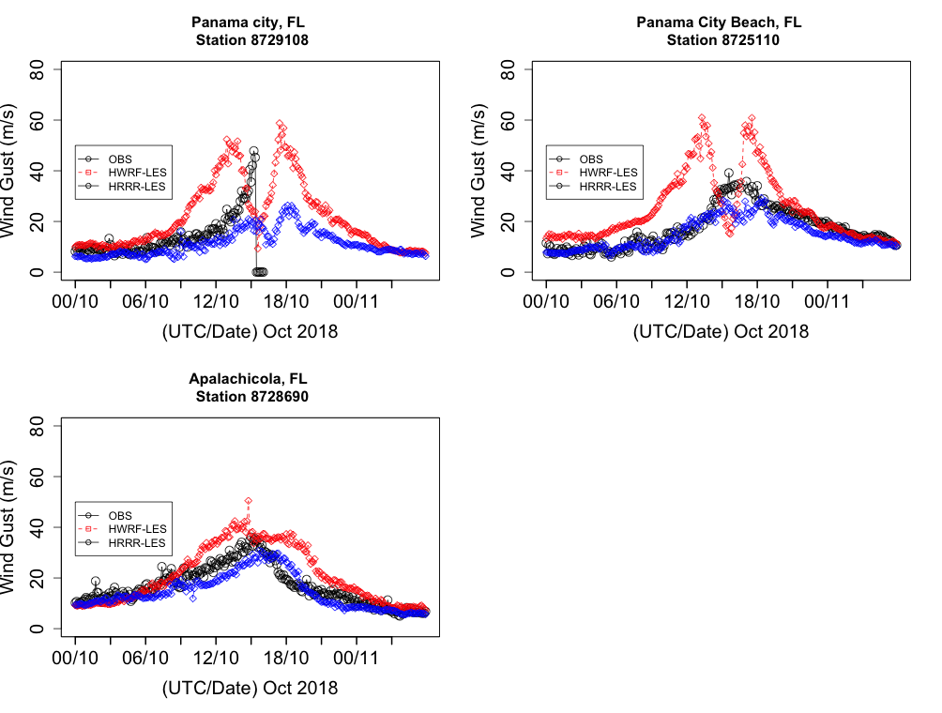
WIND GUST 6-MINS INTERVAL OBS DATA & MODEL
RED – LES USING HWRF FORCING
BLUE – LES USING HRRR FORCING
BLACK – OBSERVATIONS
6-MINS INTERVAL DATA & MODEL VALIDATIONS

Slide 13
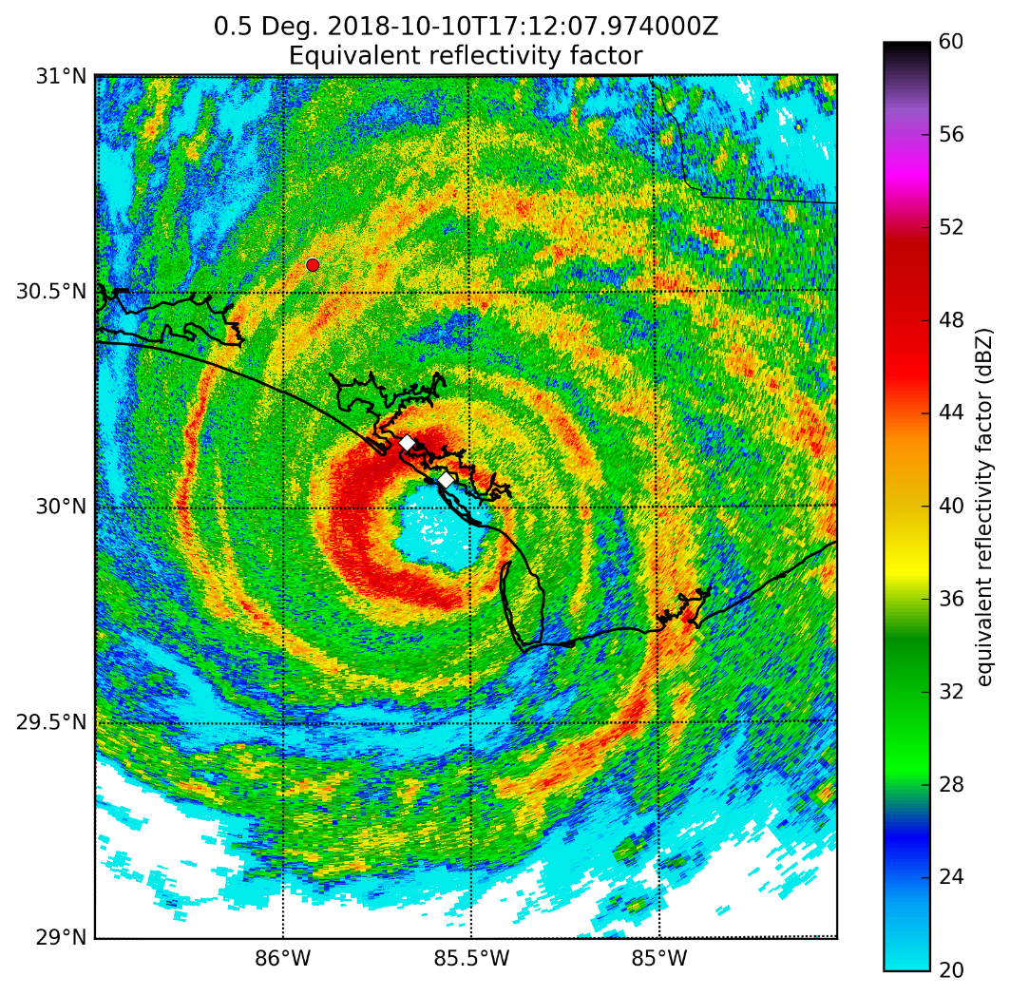
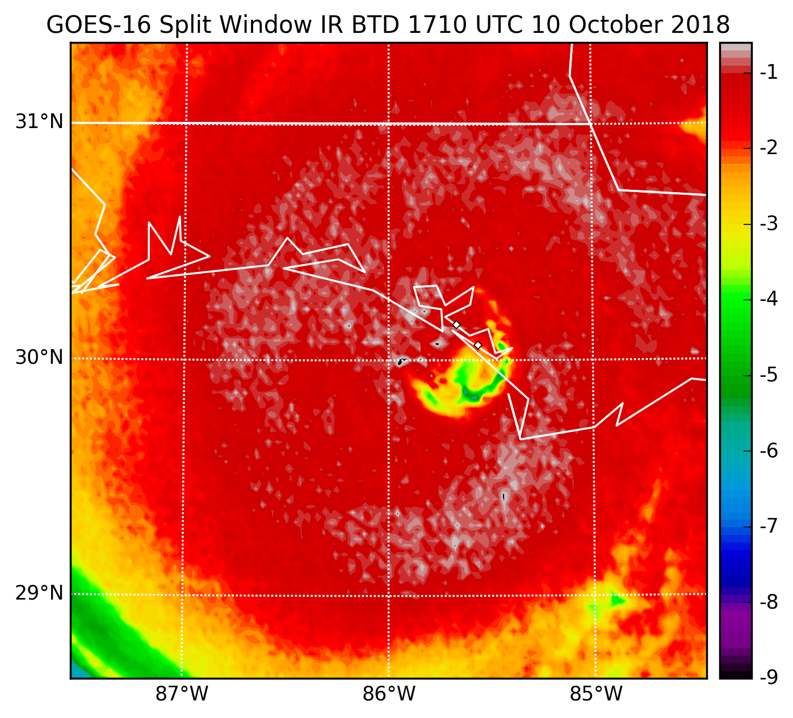
Convective
storm core
Convective storm core
T
T
NEXRAD reflectivity imagery displays that the left half of the eye-wall had evolved into a westward-oriented bowing configuration while split-window IR BTD indicates the presence of significant mid-tropospheric dry-air circulating northwestward toward a new developing convective storm core immediately inside the eye wall

Slide 14
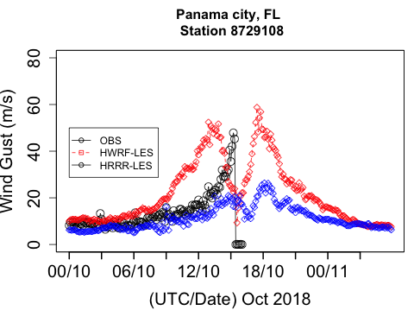
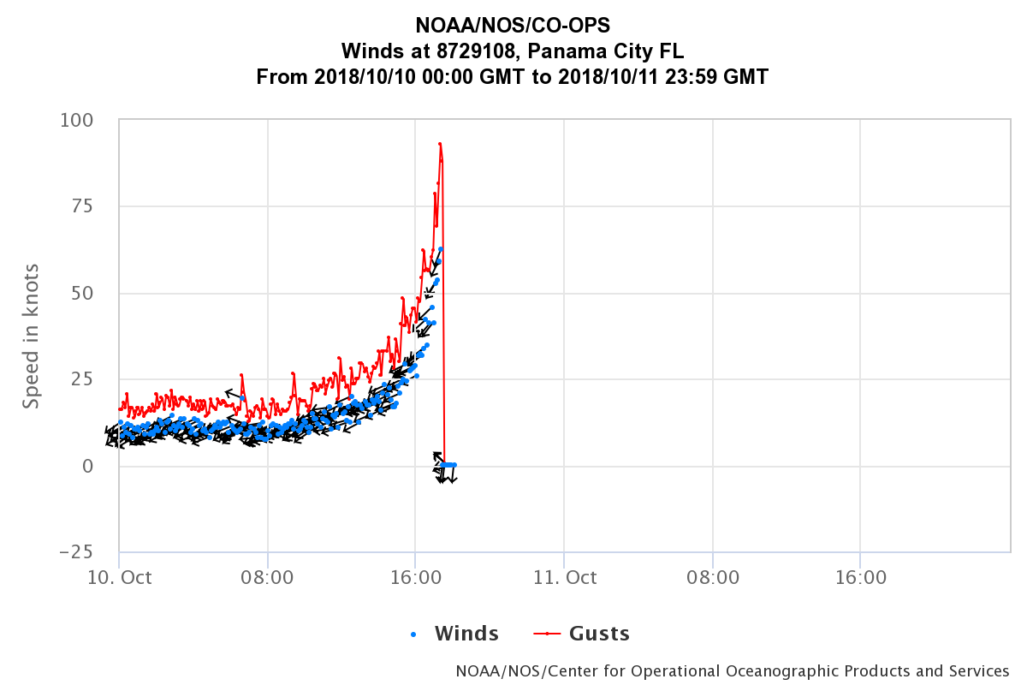
Downburst
SOURCE: Ken Pryor (NOAA)

Slide 15
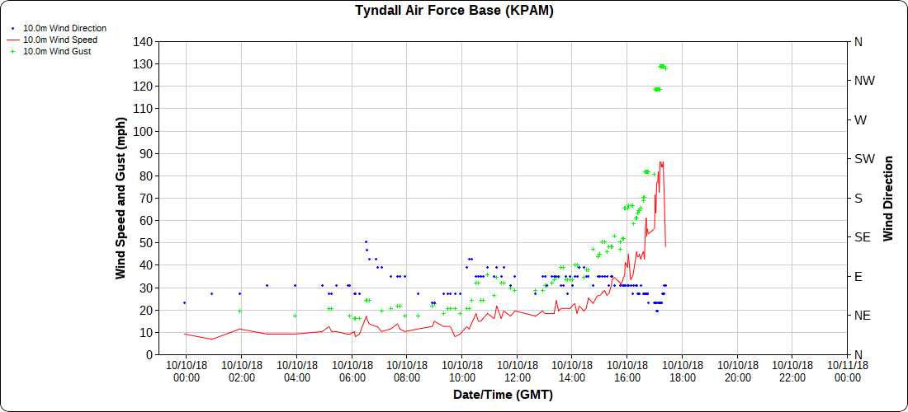
Downburst
SOURCE: Ken Pryor (NOAA)

Slide 16
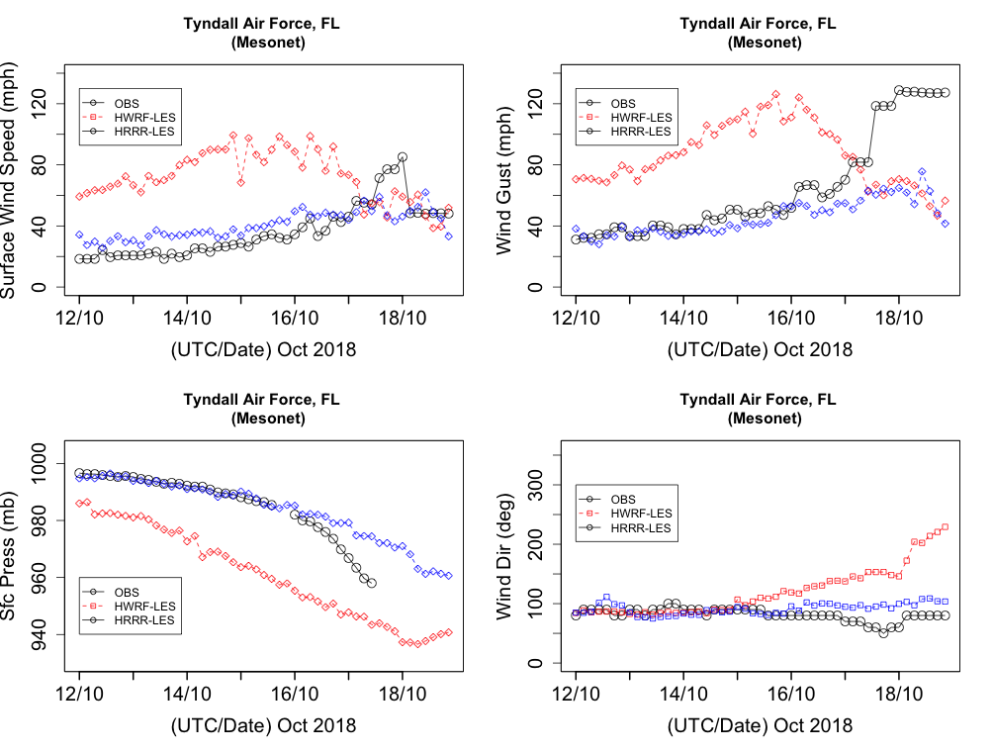
Downburst
SOURCE: Ken Pryor (NOAA)

Slide 17
Unique Characteristic of Hurricane Michael
NEXRAD reflectivity imagery displays that the left half of the eye-wall had evolved into a westward-oriented bowing configuration while split-window IR BTD indicates the presence of significant mid-tropospheric dry-air circulating northwestward toward a new developing convective storm core immediately inside the eye wall.
This type of convective storm evolution pattern was first identified with the landfall of Hurricane Frederic in September, 1979 near Mobile, Alabama and was associated with downburst wind occurrence. Similarly, during the landfall of Hurricane Michael, a new developing convective storm core over the coastal region of Panama City near Tyndall Air Force Base produced damaging downburst winds as recorded in the wind speed graph.
SOURCE: Ken Pryor (NOAA)

